Slide 1
Brain Sparks: A Personalized Educational Recommender
Rugogamu Noela
S23B38/016
B22775

Slide 2








Problem Statement
Evidence & Evaluation
Goals & Blueprint
Wrap Up & Roadmap
Core Modules

Slide 3
PART
01
Problem Statement

Slide 4

Title: Brain Sparks
Project Title
Introducing Brain Sparks: A Cognitive Educational Recommender Tailored to Uganda. This innovative project aims to bridge the gap in digital education by providing locally relevant, personalized learning paths.
Presenter Details
Presented by RUGOGAMU NOELA.
Date: December 7, 2025.
This project represents a significant step towards making advanced technology education accessible to all Ugandans.

Slide 5

Digital Divide in Uganda
Current Situation
Rural Challenges
Impact
Uganda has over 27 million mobile users and 13 million internet users, yet digital literacy in advanced fields remains extremely low. Over 70% of learners struggle to access high quality digital learning materials.
Students in rural areas face significant limitations due to unreliable internet, limited devices, and lack of contextualized content. This results in high drop in rates in self learning.
The digital divide is widening because existing tools are not designed with Uganda's context in mind. Brain Sparks addresses this by offering context aware, personalized learning.

Slide 6


Problem Statement
Core Issue
Generic search engines provide irrelevant, unstructured information that does not account for Uganda's unique challenges. Brain Sparks solves this by integrating cognitive computing principles to deliver tailored educational content.

Slide 7
PART
02
Goals & Blueprint

Slide 8

General Objective
The main goal is to design and build a cognitive educational recommender agent that fully incorporates the four pillars of cognitive computing: Understand, Reason, Learn, and Interact.
Specific Objectives
Project Objectives
Alignment with SDGs
Create an NLP module for intent and topic extraction, build a knowledge graph linking concepts and resources, integrate a feedback system, develop a user friendly web interface, and evaluate the system's performance.
This project aligns with SDG 4 (Quality Education) and SDG 9 (Industry, Innovation, and Infrastructure) by providing inclusive, localized learning paths and fostering technological innovation.

Slide 9


Methodology at a Glance
Agile Approach
Weekly Breakdown
The project followed an agile methodology over two weeks, with daily tasks, quick tests, and iterations. Development was version controlled on GitHub for transparency.
Week 1 focused on data acquisition, NLP processing, and knowledge graph construction. Week 2 involved integrating the recommendation engine, developing the user interface, and conducting evaluations.

Slide 10





System Architecture
Knowledge Graph
User Interface
Input Processing
Recommendation Engine
A Neo4j knowledge graph connects topics, resources, and applications, enabling logical reasoning and multi-hop inference for personalized recommendations.
A Streamlit web application provides an interactive interface for users to input queries, view learning paths, and provide feedback, ensuring an engaging user experience.
Queries are processed through an NLP parser that tokenizes input, extracts topics, detects Uganda specific context, and classifies user intent.
The engine uses TF-IDF for similarity scoring and graph traversal to generate step by step learning paths tailored to user queries and feedback.

Slide 11
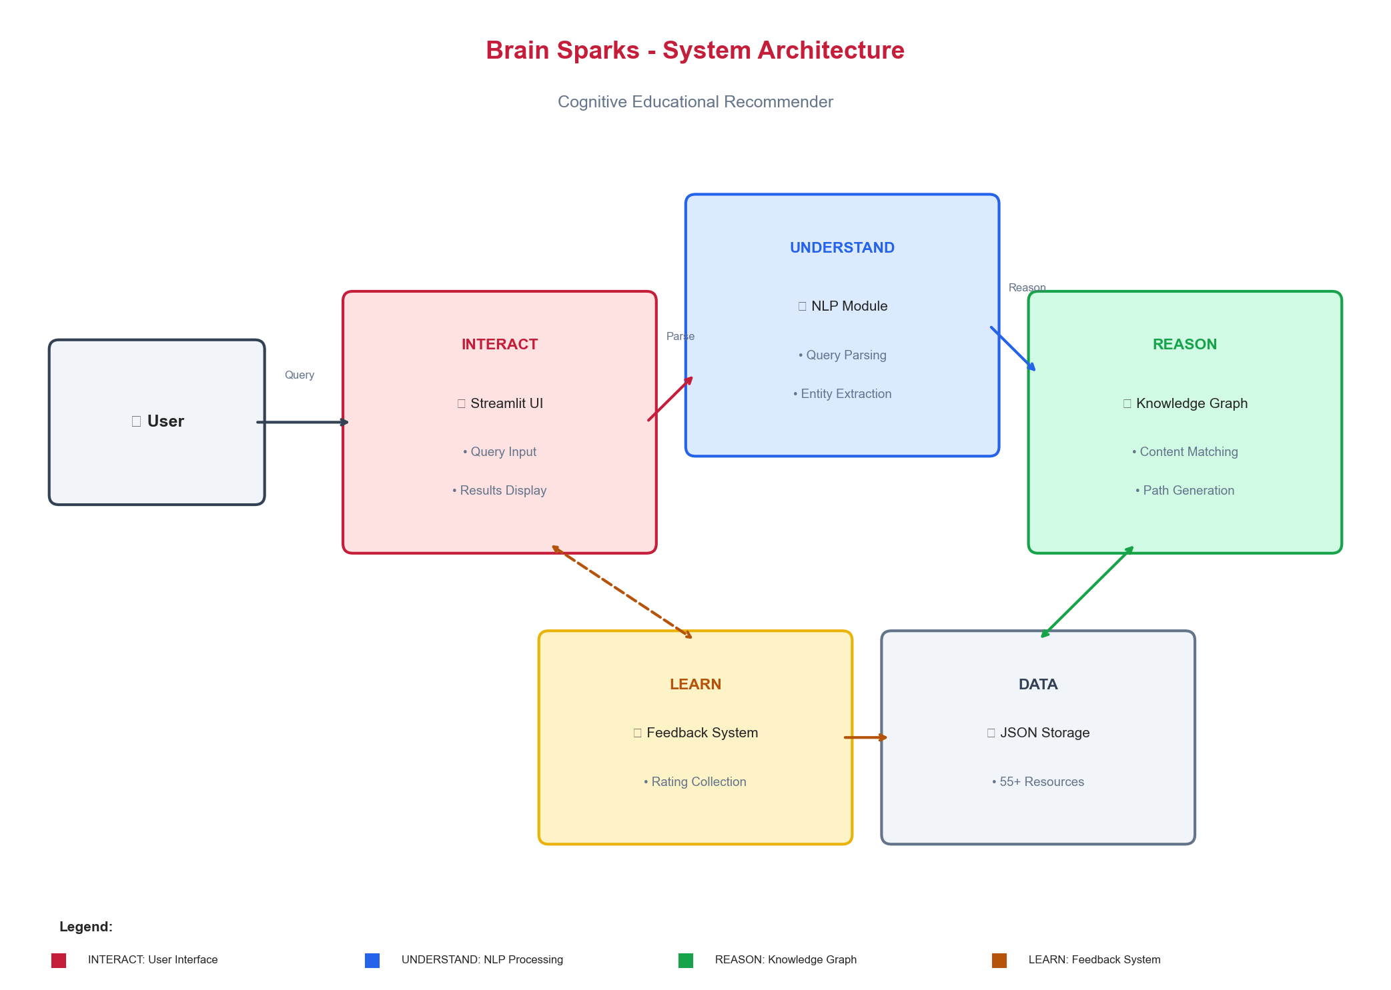
System Architecture
Knowledge Graph
User Interface
Input Processing
Recommendation Engine
A Neo4j knowledge graph connects topics, resources, and applications, enabling logical reasoning and multi-hop inference for personalized recommendations.
A Streamlit web application provides an interactive interface for users to input queries, view learning paths, and provide feedback, ensuring an engaging user experience.
Queries are processed through an NLP parser that tokenizes input, extracts topics, detects Uganda specific context, and classifies user intent.
The engine uses TF-IDF for similarity scoring and graph traversal to generate step by step learning paths tailored to user queries and feedback.

Slide 12
PART
03
Core Modules

Slide 13


Understand: NLP Engine
NLP Capabilities
The NLP engine tokenizes queries, removes stop words, and matches keywords to extract topics with over 98% accuracy. It also detects Uganda specific context and classifies user intent, handling mixed queries effectively.

Slide 14

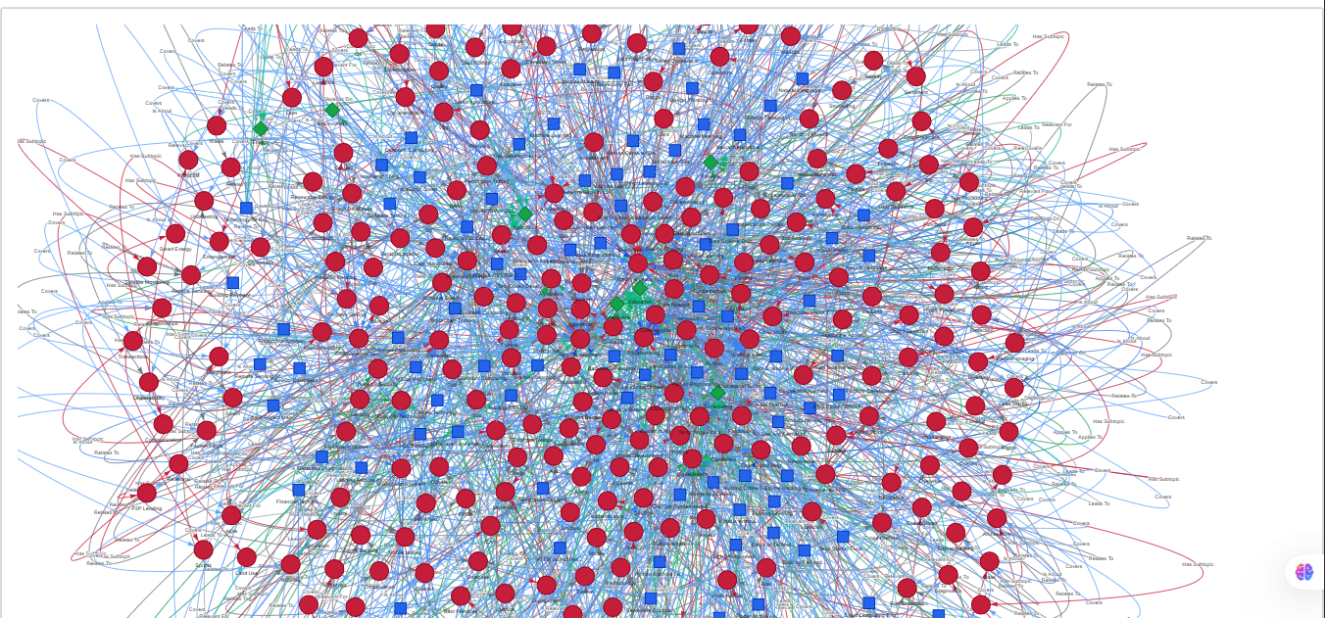
Reason: Knowledge Graph
Graph Structure
Multi Hop Inference
Local Relevance
The Neo4j knowledge graph consists of 335 nodes and 1028 edges, linking topics, resources, and applications. It enables logical connections between concepts, such as prerequisites and real-world applications.
The graph supports multi hop inference, allowing the system to reason through complex relationships and generate comprehensive learning paths based on user queries.
The knowledge graph incorporates Uganda specific applications, ensuring that recommendations are not only educational but also directly relevant to local challenges and industries.

Slide 15


Learn: Feedback Loop
Feedback Mechanism
Users can rate learning paths and provide feedback, which is stored in a JSON file. The feedback manager adjusts resource rankings based on user ratings, improving recommendation accuracy over time.
Adaptive Learning
The system learns from user interactions, adapting explanations and recommendations to better suit individual needs. This adaptive nature enhances user satisfaction and engagement.

Slide 16
Accessibility
The UI is designed to be mobile friendly and low bandwidth optimized, ensuring accessibility for users with limited internet connectivity.
User Friendly Interface
The Streamlit web application provides a clean, intuitive interface with search bars, expandable learning paths, and interactive knowledge graph visualizations.
Interact: Streamlit UI
Feedback Submission
Offline Capabilities
Users can easily submit feedback through the interface, helping the system learn and improve future recommendations.
The system supports offline use, allowing users to access learning paths and resources even without an active internet connection.

Slide 17
PART
04
Evidence & Evaluation

Slide 18



Results Snapshot
Key Metrics
The system achieved precision@3 of 85%, precision@5 of 78%, topic accuracy of 95%, and Uganda relevance detection of 90%. These results demonstrate its effectiveness in providing relevant, localized recommendations.
Sample Path
A sample learning path for quantum computing includes a beginner article on qubits, an intermediate video on algorithms, and an advanced quiz on optimizing power grids in Uganda.
Comparison
Brain Sparks outperforms baseline keyword search by 40% in BLEU scores and human judgment, highlighting its superior ability to provide contextually relevant and connected responses.

Slide 19

Comparison Table
Comparison with Baselines
Brain Sparks vs. Google Search vs. Generic Chatbot: Brain Sparks excels in local context, prerequisite reasoning, feedback adaptation, and offline use, significantly enhancing user satisfaction and learning outcomes.

Slide 20
PART
05
Wrap Up & Roadmap

Slide 21

Conclusion
Future Potential
The system is ready for integration into national e-learning platforms, empowering students, professionals, and innovators across Uganda with practical, context aware learning experiences.
Achievements
Brain Sparks successfully demonstrates how cognitive computing can transform education by providing localized, adaptive learning paths. It meets SDG 4 and 9, making advanced technology education accessible to all Ugandans.

Slide 22






Future Work
Scale the dataset via web crawling and open-data APIs to enhance the system's breadth and depth of knowledge, covering more niche queries and applications.
Develop a mobile version of the application, optimized for offline use and low bandwidth environments, ensuring accessibility for users with limited internet connectivity.
Dataset Expansion
Mobile Optimization
Multilingual Support
Nationwide Pilot
Add support for local languages like Luganda using multilingual models to make the system accessible to a broader audience in Uganda.
Conduct extensive user testing and pilot programs in partnership with educational institutions to refine the system and validate its educational impact.

Slide 23

THANK YOU
RUGOGAMU NOELA
S23B38/016
B22775

